Slide 1
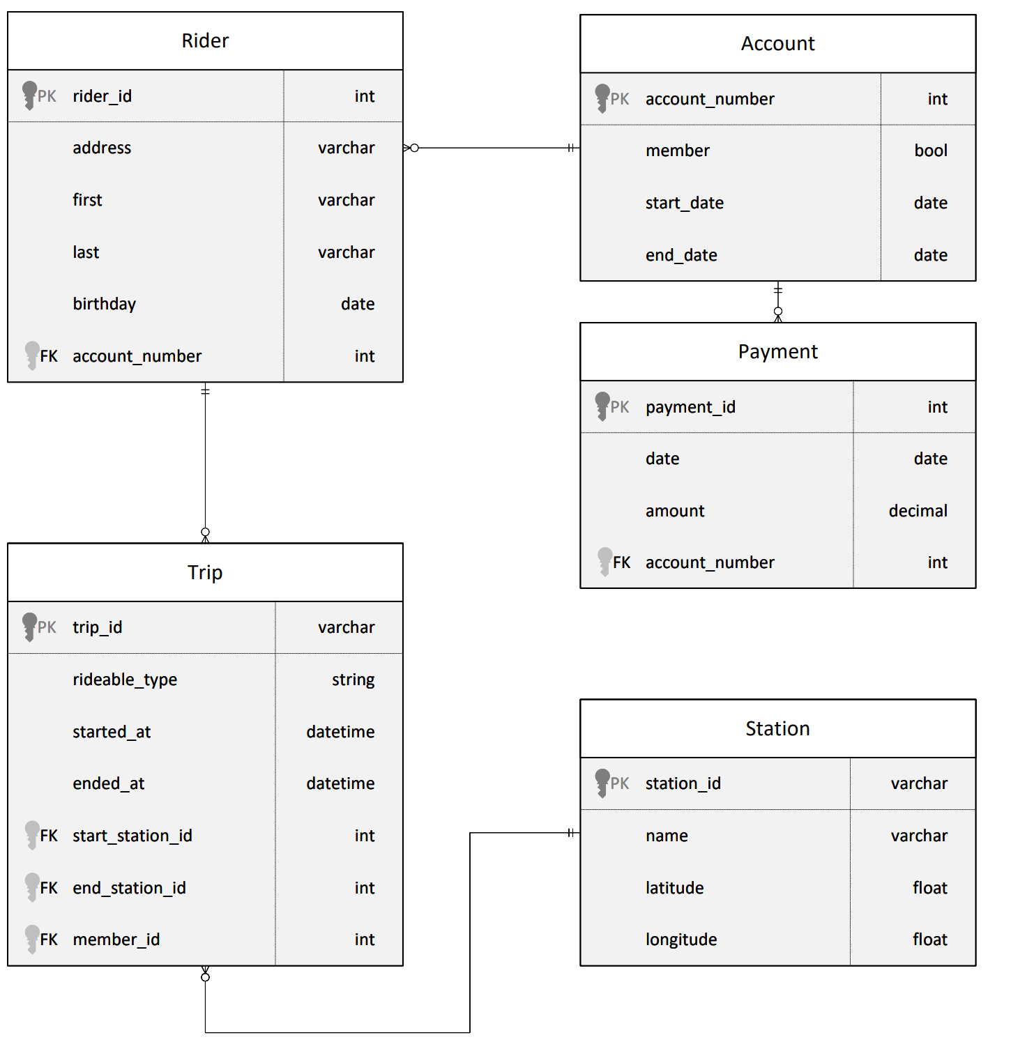

Project: Building an Azure Data Warehouse for Bike Share Data Analytics
Project Overview
Divvy is a bike sharing program in Chicago, Illinois USA that allows riders to purchase a pass at a kiosk or use a mobile application to unlock a bike at stations around the city and use the bike for a specified amount of time. The bikes can be returned to the same station or to another station. The City of Chicago makes the anonymized bike trip data publicly available for projects like this where we can analyze the data.
Since the data from Divvy are anonymous, we have created fake rider and account profiles along with fake payment data to go along with the data from Divvy.
The dataset looks like this:
The goal of this project is to develop a data warehouse solution using Azure Synapse Analytics. You will:
Design a star schema based on the business outcomes listed below;
Import the data into Synapse;
Transform the data into the star schema;
and finally, view the reports from Analytics.

Slide 2
Project: Building an Azure Data Warehouse for Bike Share Data Analytics
The business outcomes you are designing for are as follows:
Analyze how much time is spent per ride
Based on date and time factors such as day of week and time of day
Based on which station is the starting and / or ending station
Based on age of the rider at time of the ride
Based on whether the rider is a member or a casual rider
Analyze how much money is spent
Per month, quarter, year
Per member, based on the age of the rider at account start
EXTRA CREDIT - Analyze how much money is spent per member
Based on how many rides the rider averages per month
Based on how many minutes the rider spends on a bike per month

Slide 3
Project: Building an Azure Data Warehouse for Bike Share Data Analytics
Project Environment
In order to complete this project, you'll need to use these tools:
Access to Microsoft Azure. Instructions for accessing an Azure account where you can create the resources necessary for the project are on the previous page
Python to run the script to load data into a PostgreSQL database on Azure to simulate your OLTP data source
An editor to work with the Python and SQL scripts, we recommend Visual Studio Code
Local Machine Instructions
To work locally on this project, you'll need to have Python and Visual Studio Code installed, or another editor of your choice to run Python scripts.
Starter Code and Data
You'll need a Python script found in the Github project starter repository. Instructions for using this script for loading data are on the next page, in the project instructions
You'll need the dataset from the course resources menu in the left navigation bar. Instructions for how to use the data in your project are on the next page in the project instructions.

Slide 4
Project: Building an Azure Data Warehouse for Bike Share Data Analytics
Project Instructions
Task 1: Create your Azure resources
Create an Azure PostgreSQL database
Create an Azure Synapse workspace
Create a Dedicated SQL Pool and database within the Synapse workspace
Note that if you've previously created a Synapse Workspace, you do not need to create a second one specifically for the project.
Task 2: Design a star schema
You are being provided a relational schema that describes the data as it exists in PostgreSQL. In addition, you have been given a set of business requirements related to the data warehouse. You are being asked to design a star schema using fact and dimension tables.
Task 3: Create the data in PostgreSQL
To prepare your environment for this project, you first must create the data in PostgreSQL. This will simulate the production environment where the data is being used in the OLTP system. This can be done using the Python script provided for you in Github: ProjectDataToPostgres.py
Download the script file and place it in a folder where you can run a Python script
Download the data files from the classroom resources
Open the script file in VS Code and add the host, username, and password information for your PostgreSQL database
Run the script and verify that all four data files are copied/uploaded into PostgreSQL
You can verify this data exists by using pgAdmin or a similar PostgreSQL data tool.

Slide 5
Project: Building an Azure Data Warehouse for Bike Share Data Analytics
Task 4: EXTRACT the data from PostgreSQL
In your Azure Synapse workspace, you will use the ingest wizard to create a one-time pipeline that ingests the data from PostgreSQL into Azure Blob Storage. This will result in all four tables being represented as text files in Blob Storage, ready for loading into the data warehouse.
Task 5: LOAD the data into external tables in the data warehouse
Once in Blob storage, the files will be shown in the data lake node in the Synapse Workspace. From here, you can use the script generating function to load the data from blob storage into external staging tables in the data warehouse you created using the Dedicated SQL Pool.
Task 6: TRANSFORM the data to the star schema
You will write SQL scripts to transform the data from the staging tables to the final star schema you designed.
Helpful Hints
When you use the ingest wizard, it uses the copy tool to EXTRACT into Blob storage. During this process, Azure Synapse automatically creates links for the data lake. When you start the SQL script wizard to LOAD data into external tables, start the wizard from the data lake node, not the blob storage node.
When using the external table wizard, you may need to modify the script to put dates into a varchar field in staging rather than using the datetime data type. You can convert them during the transform step.
When using the external table wizard, if you rename the columns in your script, it will help you when writing transform scripts. By default, they are named [C1], [C2], etc. which are not useful column names in staging.

Slide 6
Project: Building an Azure Data Warehouse for Bike Share Data Analytics
Submission Instructions
Here is a list of things to submit for this project. Create a zip file containing:
PDF of the star schema you designed based on the relational diagram and the business problems outlined
Screenshot of your linked Azure Blob storage showing the 4 datasets copied in from Postgres (Proof of Extract step)
Copy / paste of the script used for the external table create and load (Proof of Load step). You will have 4 of these, one for each source table.
SQL code for creating each of the tables in your star schema
Your submission will be assessed against this rubric
Take a moment and make sure your project is complete before submitting it.

